Slide 1

Data Structures And Algorithms Odd Semester 2022
Computer Science and Engineering
Jaypee Institute Of Information Technology (JIIT), Noida

Slide 2
Outline
Backtracking Algorithm-
Introduction to Backtracking
Recursive Backtracking
Non-recursive backtracking
State space tree
Backtracking Algorithm Applications

Slide 3
Backtracking
A backtracking algorithm is a problem-solving algorithm that uses a brute force approach for finding the desired output.
The Brute force approach tries out all the possible solutions and chooses the desired/best solutions.
The term backtracking suggests that if the current solution is not suitable, then backtrack and try other solutions. Thus, generally, recursion is used in this approach.
This approach is used to solve problems that have multiple solutions. If you want an optimal solution, you must go for dynamic programming.

Slide 4
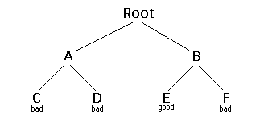
Backtracking
Consider the following example in which the objective is to reach the good leaf. Suppose you get to a bad leaf. You can backtrack to continue the search for a good leaf by revoking your most recent choice, and trying out the next option in that set of options.
If you run out of options, revoke the choice that got you here, and try another choice at that node. If you end up at the root with no options left, there are no good leaves to be found.

Slide 5
Backtracking
To reach the good leaf following sequence of operations could be performed.
Starting at Root, your options are A and B. You choose A.
At A, your options are C and D. You choose C.
C is bad. Go back to A.
At A, you have already tried C, and it failed. Try D.
D is bad. Go back to A.
At A, you have no options left to try. Go back to Root.
At Root, you have already tried A. Try B.
At B, your options are E and F. Try E.
E is good. Congratulations!

Slide 6
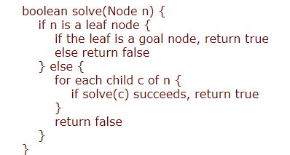
Recursive Backtracking
Consider the following tree in which our objective is to reach the good leaf.
To reach the good solution, a sequence of actions (discussed in previous slide) are performed.
To achieve our objective, we start with root node and eliminate choices that are obviously not possible and proceed to recursively check only those that have potential. This way, at each depth of the tree, we mitigate the number of choices to consider in the future.
The pseudo code of recursive backtracking to achieve the good solution is given below-

Slide 7
Non-recursive Backtracking
Non-recursive backtracking is implemented using stack. To reach the objective following actions are performed for non-recursive backtracking approach.
First, root is pushed onto stack
Find the children of root i.e., A, B and push any of
The child into stack. Here we push A
Since, A is on the top of stack find its children i.e., C, D
Push any of child into stack, we pushed C
C is the leaf node, so check whether it is good or not.
As, C is bad so we pop C from stack. Now A will be on the top of stack. Push
other child into stack i.e., D is also bad solution so pop D
Now, A is on the top of stack and both of its children have been processed, so pop A and push
another child of Root i.e. B onto stack and find its children i.e., E, F.
Now push E into stack and check whether it is good solution or not. Since, E is good solution, so we will stop here.
E
C D B
A
root

Slide 8
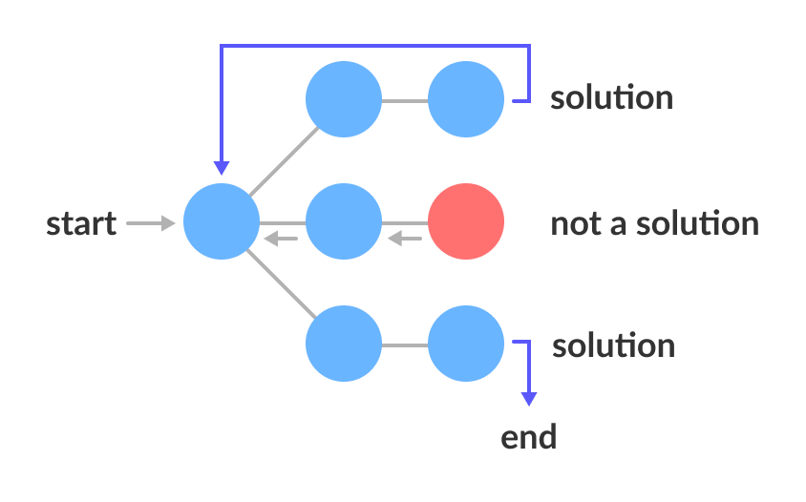
Backtracking: State Space Tree
A space state tree is a tree representing all the possible states (solution or non-solution) of the problem from the root as an initial state to the leaf as a terminal state.
An example of state space tree is presented in the following figure-
From the figure, it can be observed that there are two acceptable solutions for given problem. The state space tree represents all the possible solutions of a backtracking problem.
State Space Tree

Slide 9
Backtracking: State Space Tree
The state space tree is typically search depth first and the nodes are implicit meaning they are generated as need. A node is said to be promising if the partial solution is still feasible. Any time the partial node becomes infeasible the node, called non-promising the branch will no longer be pursued. So, the algorithm backtracks to the first promising node and explores the other branches of the state-space tree.
In state space first an abstract tree is created which is further explored in DFS order to get all the possible solutions.
The steps are presented in the next slide to search the promising nodes in a tree.

Slide 10
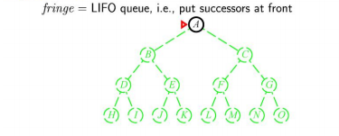
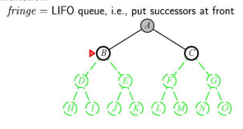
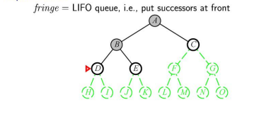
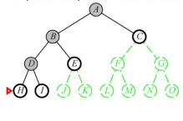
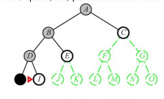
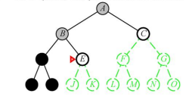
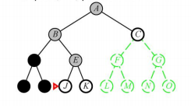
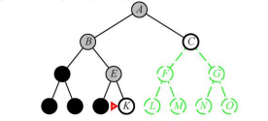
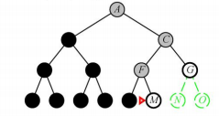
…
…

Slide 11
Backtracking algorithm applications
N-queen problem
Rat in maze problem
Sudoku
Permutations
Subset sum problems
Hamiltonian Circuit Problems

Slide 12
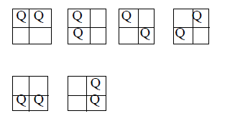
N-queen problem
N - Queens problem is to place n - queens in such a manner on an n x n chessboard that no queens attack each other by being in the same row, column or diagonal.
It can be seen that for n =1, the problem has a trivial solution, and no solution exists for n =2 and n =3.

Slide 13
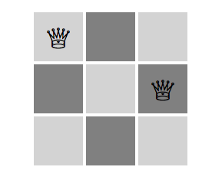
N-queen problem
N - Queens problem is to place n - queens in such a manner on an n x n chessboard that no queens attack each other by being in the same row, column or diagonal.
It can be seen that for n =1, the problem has a trivial solution, and no solution exists for n =2 and n =3.

Slide 14
N-queen problem
So first we will consider the 4 queens problem and then generate it to n - queens problem.
Given a 4 x 4 chessboard and number the rows and column of the chessboard 1 through 4. The following represents one of the possible solution.
 |  | Q1
Q2
 |  |  | Q3
 | Q4

Slide 15
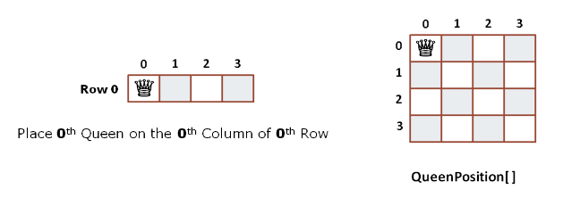
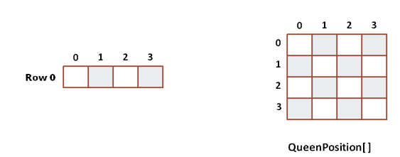

N-queen problem
The 4-queen problem can be placed to correct positions using the following steps.

Slide 16
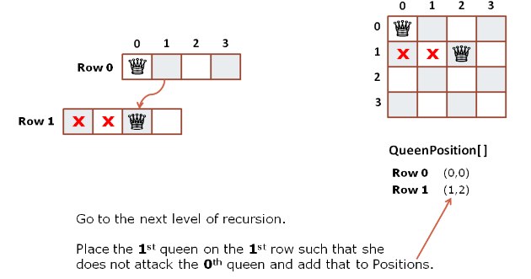
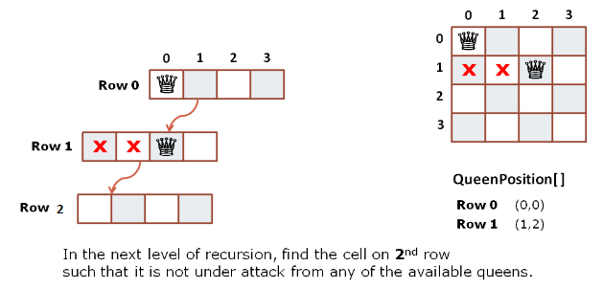
N-queen problem

Slide 17
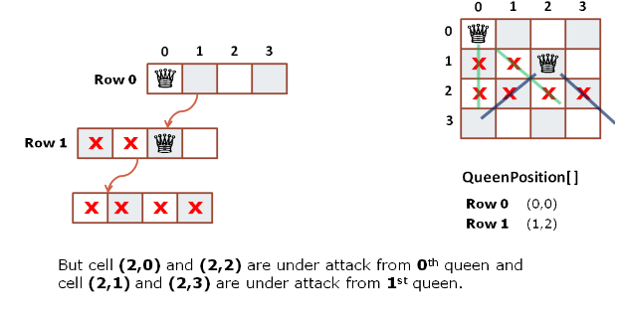
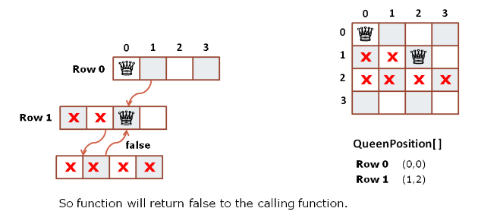
N-queen problem

Slide 18
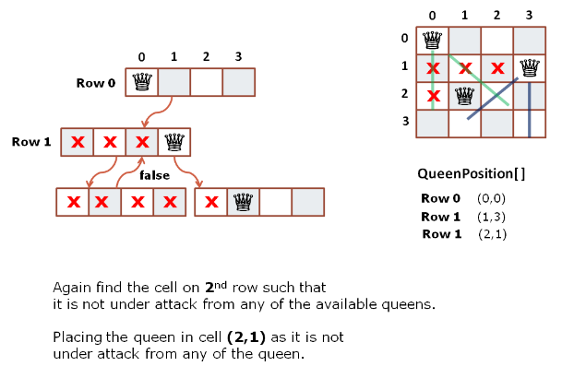
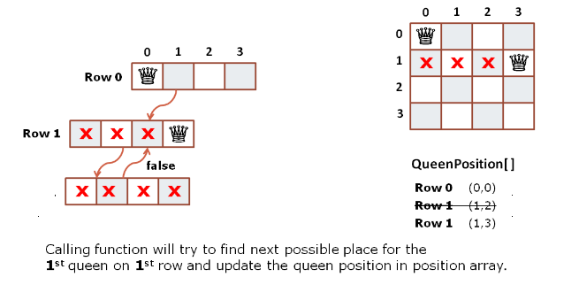
N-queen problem

Slide 19
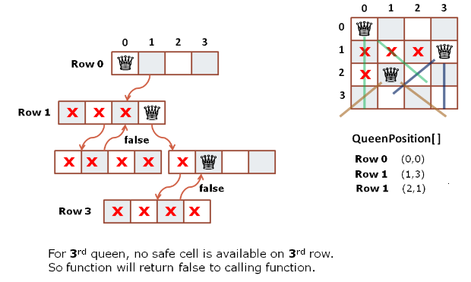
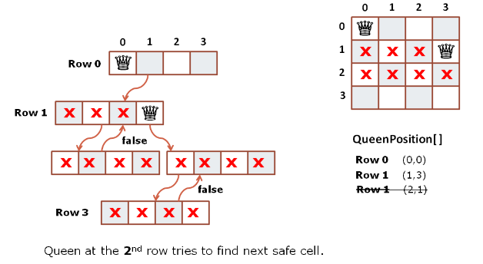
N-queen problem

Slide 20
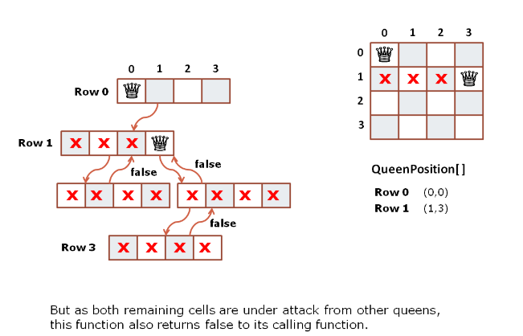
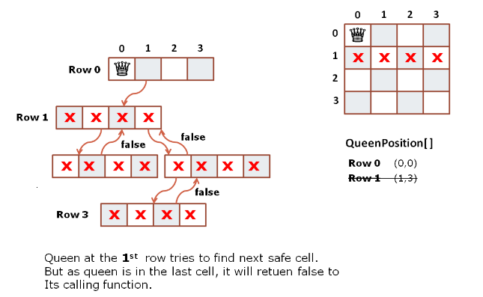
N-queen problem

Slide 21
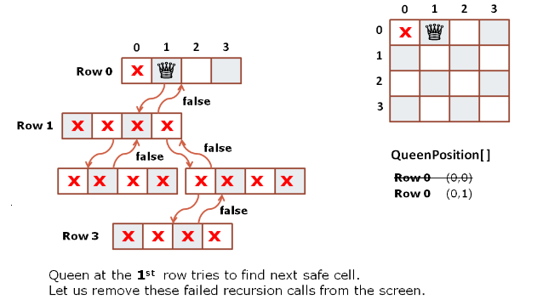
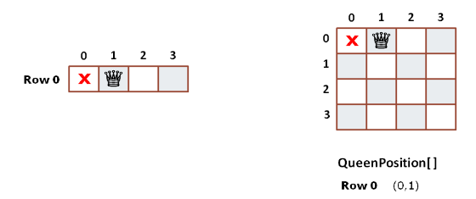
N-queen problem

Slide 22
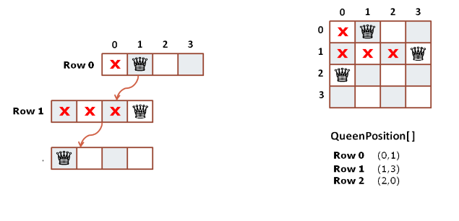
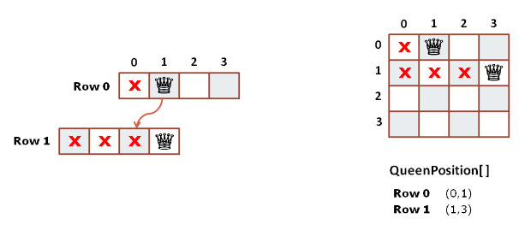
N-queen problem

Slide 23
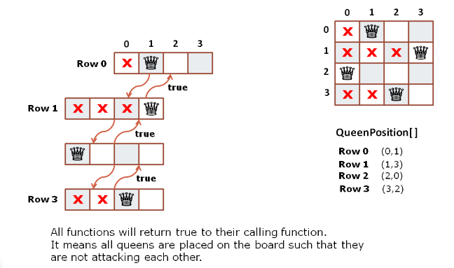
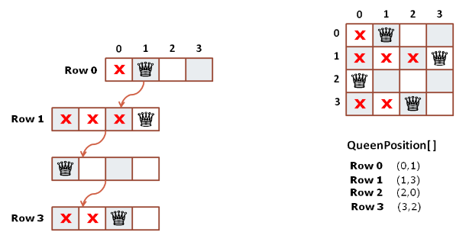
N-queen problem
There can be more than one possible solutions for the n-queen problem. To get all the possible solutions state-space diagram are generally constructed. The same is discussed in the following sections.

Slide 24
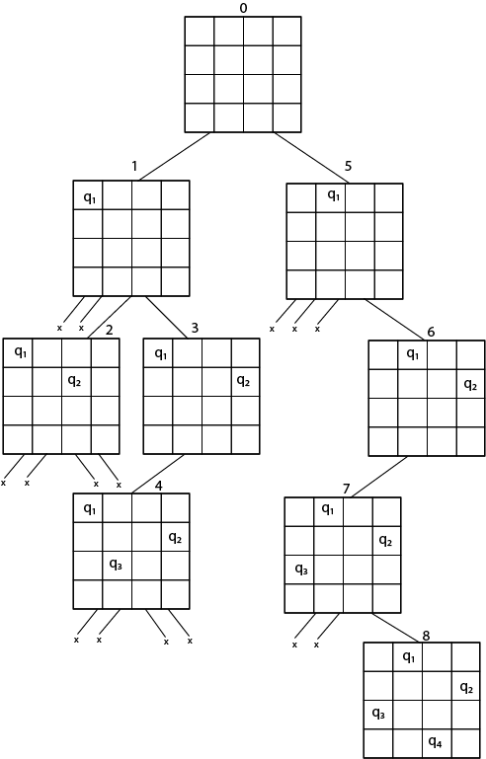
N-queen problem
Since, we have to place 4 queens such as q₁ q₂ q₃ and q₄ on the chessboard, such that no two queens attack each other. In such a conditional each queen must be placed on a different row, i.e., we put queen "i" on row “i” means one row will have only one queen. So, for simplicity we will only store column number where queen has to be placed.
we first place queen q₁ in the very first acceptable position (1, 1).
Next, we put queen q₂ so that both these queens do not attack each other. We find that if we place q₂ in column 1 and 2, then the dead end is encountered. Thus the first acceptable position for q₂ in column 3, i.e. (2, 3) but then no position is left for placing queen 'q₃' safely (Easily understood from the figure).

Slide 25
N-queen problem
So we backtrack one step and place the queen 'q₂' in (2, 4), the next best possible solution. Then we obtain the position for placing 'q₃' which is (3, 2).
However, later this position also leads to a dead end, and no place is found where 'q₄' can be placed safely. Then we have to backtrack till 'q₁' and place it to (1, 2) and then all other queens are placed safely by moving q₂ to (2, 4), q₃ to (3, 1) and q₄ to (4, 3). So, solution can be written using column numbers as (2,4, 1,3).
This is one possible solution for the 4-queens problem. For another possible solution, the whole method is repeated for all partial solutions and state space tree could be constructed. The other solutions for 4 - queens problems is (3, 1, 4, 2)

Slide 26
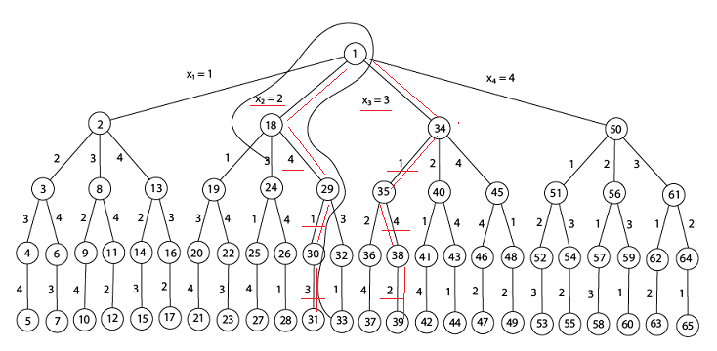
N-queen problem
Fig shows the complete state space for 4 - queens problem. But we can use backtracking method to generate the necessary node and stop if the next node violates the rule, i.e., if two queens are attacking.
From the state space tree following two solutions is found.
[2,4,1,3]
[3,1,4,2]
Fig - Queens solution space with nodes numbered in DFS

Slide 27
int cboard[20],c;
int main()
{
int num,i,j;
void queen(int row,int num);
printf(" - N Queens Problem Using Backtracking -");
printf("\n\nEnter number of Queens:");
scanf("%d",&num);
queen(1,num);
return 0;
}
//function for printing the solution
void print(int num)
{ int i,j;
printf("\n\nSolution %d:\n\n",++c);
for(i=1;i<=num;++i)
printf("\t%d",i);
for(i=1;i<=num;++i)
{ printf("\n\n%d",i);
for(j=1;j<=num;++j) //for nxn board
{
if(cboard[i]==j)
printf("\tQ"); //queen at i,j position
else
printf("\t-"); //empty slot
}
}
}
/*funtion to check conflicts If no conflict for desired postion returns 1 otherwise returns 0*/
int place(int row,int column)
{
int i;
for(i=1;i<=row-1;++i)
{
//checking column and diagonal conflicts
if(cboard[i]==column)
return 0;
else
if(abs(cboard[i]-column)==abs(i-row))
return 0;
}
return 1; //no conflicts
}
//function to check for proper positioning of queen
void queen(int row,int num)
{ int column;
for(column=1;column<=num;++column)
{ if(place(row,column))
{ cboard[row]=column; //no conflicts so place queen
if(row==num) //dead end
print(num); //printing the board configuration
else //try queen with next position
queen(row+1,num);
}
} }

Slide 28
References
https://www.javatpoint.com/backtracking-introduction
https://codepumpkin.com/n-queen-problem/
http://www.csl.mtu.edu/cs4321/www/Lectures/Lecture%2026%20-%20Backtracking.htm

